Slide 1

Project Name: Solar Smart Student Name: Arya Dashputra,Rugwed Yawalkar, Institution Name :- Symbiosis Institute of Technology, Nagpur

Slide 2
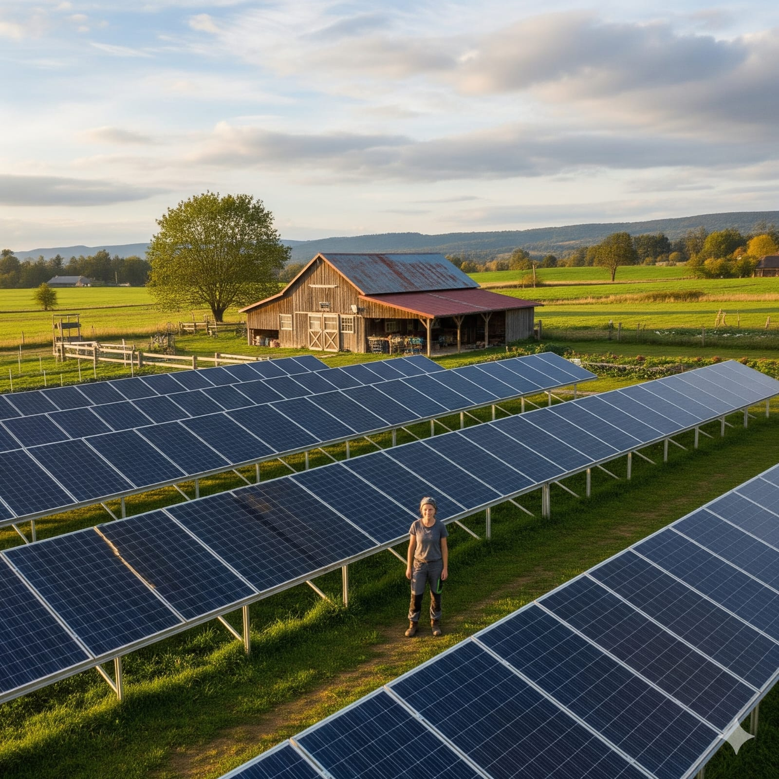
The Problem: The High Cost of Silence
Meet Sarah. She runs a medium-sized commercial solar farm. Last month, a single undetected panel failure snowballed into a cascade event, taking a whole section of her farm offline for three days. This wasn't just a minor glitch; it was a catastrophic financial failure. The Cost: A ₹1.9 Lakh revenue loss from a single, preventable fault. This figure combined with the cost of lost energy with emergency repairs, downtime, and grid penalties makes ₹29 Lakh revenue loss for 1MW solar Plant. This same problem affects homeowners like Arya.
While the numbers are smaller, the principle is identical. For him, a couple of dirty, underperforming panels went unnoticed for a 4 months, silently costing his family over ₹11,000 in lost savings.

Slide 3
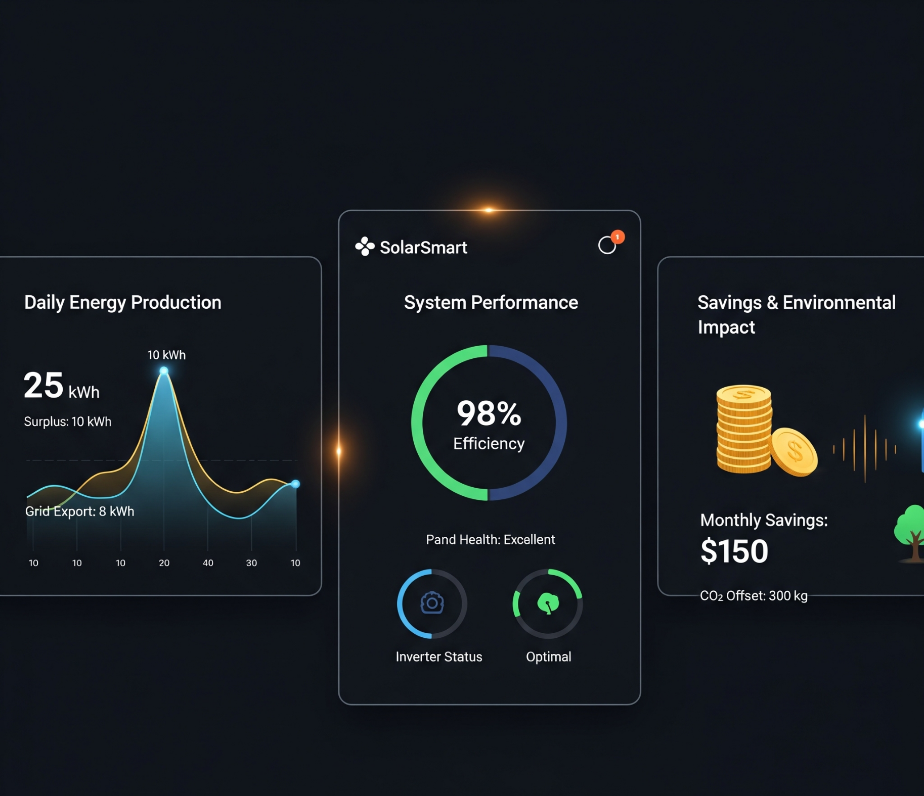
The Solution: An Intelligence Layer for Solar
SolarSmart.ai: We are an AI-powered co-pilot that gives your solar assets a voice. We turn data into proactive, profit-driven decisions.
Our patented platform turns millions of data points into three critical advantages:
Instant Anomaly Detection: Find faults in real-time before they cost you.
Intelligent Yield Optimization: Get concrete advice to boost output by up to 20%.
Predictive Forecasting: See energy output with over 85% accuracy with our What If Simulator
We stop losses and unlock hidden revenue.

Slide 4





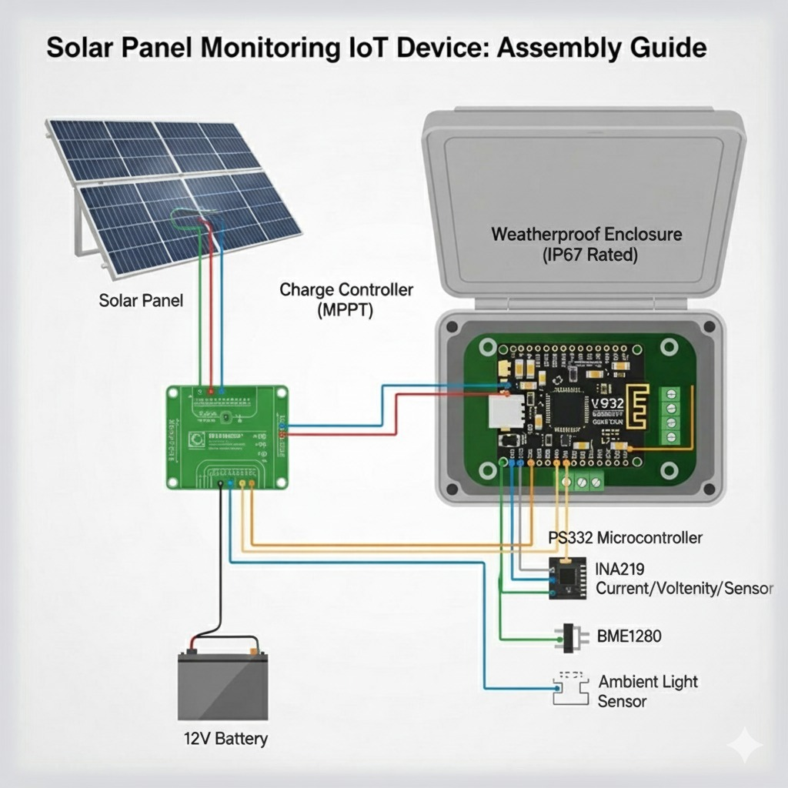


Technology Stack
Frontend Layer – User Interface
Cloud & Backend Layer - The Brains
Machine Learning AI Core
Hardware Layer – The Edge

Slide 5
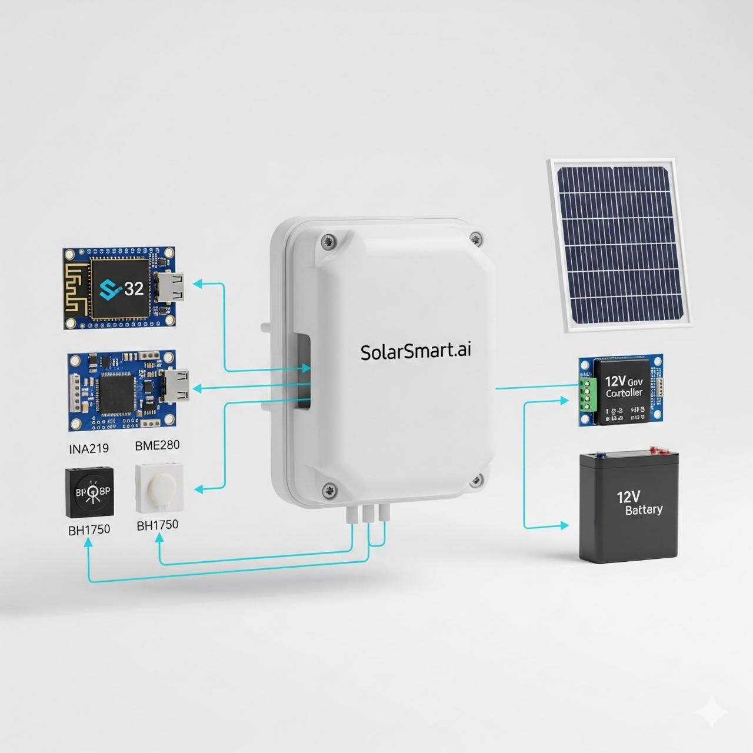
Our Value: From a 1 MW Farm to a Rooftop
For a 1 MW Commercial Farm | For the Homeowner
Potential Annual Value: Up to ₹40 Lakhs | Potential Annual Value: Over ₹11,000 + Smarter Savings
~₹20 Lakhs from Yield Optimization | Up to 20% more energy generated by alerting you to dirty or faulty panels.
~₹15 Lakhs in Risk Mitigation | Smarter Financial Planning
~₹5 Lakhs from Predictive Forecasting | Pays for itself in under a year, turning a small investment into pure savings.
5

Slide 6
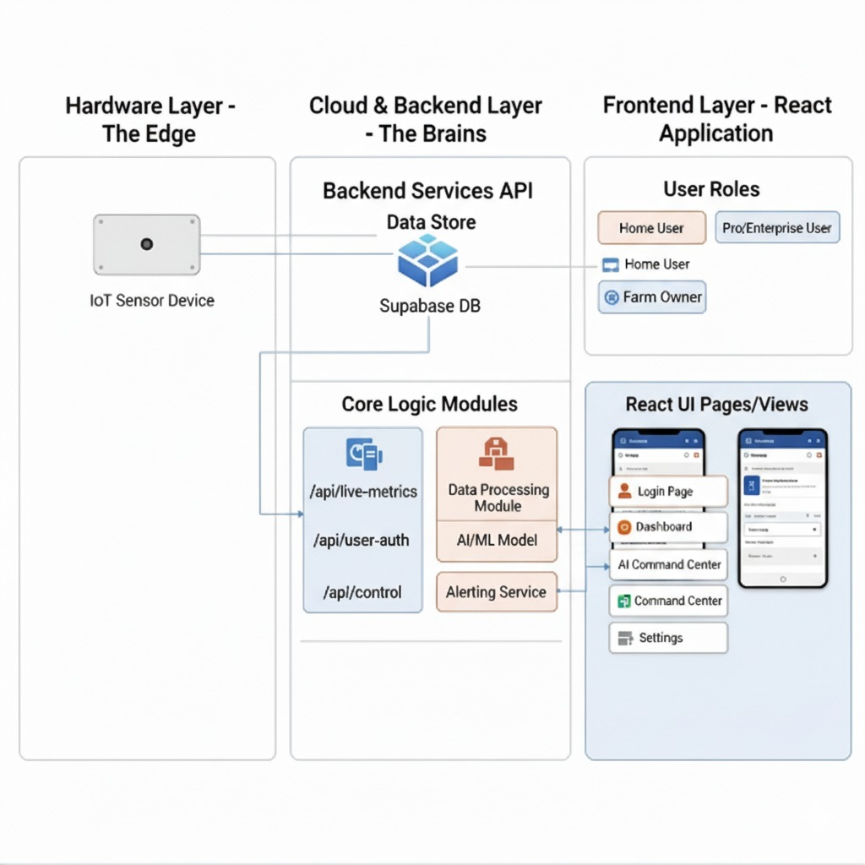
Block Diagram and Workflow
Workflow Diagram
Assembly Guide Block Diagram

Slide 7

A Targeted Product for a Proven Market
Our go-to-market strategy
 | SolarSmart Home 🏡 | SolarSmart Pro 🚜 | SolarSmart Enterprise 🏢
The Customer | Rooftop Homeowners. | Commercial & Agri-Operators. | Large-Scale Utility Operators.
The Value | Simple, affordable | AI-Powered Financial Optimization. | Portfolio-wide intelligence to predict failures and drive returns.
The Price | ₹4,999 one-time (₹295/m^2) | ₹15,300 + SaaS fee (₹90/m^2) | ~₹1.5 Lakhs/year custom license (Varies with the portfolio)

Slide 8
Thank You

